Slide 1

Leaf health Detection
Presented By
Kundan Kumar-17cs084
Kola Ganesh-17cs078
Kavindra Yadav-17cs181
Under the Guidance of Vidya Shree D M
Assistant Professor CSE Department
Approved by AICTE |Affiliated to VTU | Recognized by UGC with 2(f) & 12(B) status |Accredited by NBA and NAAC

Slide 2
Introduction
The primary occupation in India is agriculture. India ranks second in the agricultural output worldwide.
Here in India, farmers cultivate a great diversity of crops.
Various factors such as climatic conditions, soil conditions, various disease, etc affect the production of the crops.
The existing method for plants disease detection is simply naked eye observation which requires more man labor, properly equipped laboratories, expensive devices
Approved by AICTE |Affiliated to VTU | Recognized by UGC with 2(f) & 12(B) status |Accredited by NBA and NAAC

Slide 3
Identification of Problem
The primary occupation in India is agriculture. India ranks second in the agricultural output worldwide. Here in India, farmers cultivate a great diversity of crops. Various factors such as climatic conditions, soil conditions, various disease,etc affect the production of the crops.
The proposed system helps in identification of plant disease and provides remedies that can be used as a defense mechanism against the disease.
The plant disease detection can be done by observing the spot on the leaves of the affected plant. The method we are adopting to detect plant diseases is image processing using Convolution neural network(CNN).
Approved by AICTE |Affiliated to VTU | Recognized by UGC with 2(f) & 12(B) status |Accredited by NBA and NAAC

Slide 4
Aim
Our Aim of this Project is to help people in various sectors especially Agriculture sector to avoid the plants from getting disease which may lead them drying and dying.
Our Project is going to use Convolutional Neural Network (CNN) machine learning model in which we feed the image of the leaf as input and get output as accuracy along with the disease name and remedy if a plant leaf is not healthy.
The database obtained from the Internet is properly segregated and the different plant species are identified and are renamed to form a proper database then obtain test-database which consists of various plant diseases that are used for checking the accuracy and confidence level of the project
Approved by AICTE |Affiliated to VTU | Recognized by UGC with 2(f) & 12(B) status |Accredited by NBA and NAAC

Slide 5
The main objective is to identify the plant diseases using image processing.
After the model is trained successfully ,the software can identify the disease if the plant species is contained in the database.
After successful training and preprocessing ,comparison of the test image and trained model takes place to predict the disease.
After the disease is successfully predicted with a good confidence level , the corresponding remedy for the disease present is displayed that can be taken as a cure.
Approved by AICTE |Affiliated to VTU | Recognized by UGC with 2(f) & 12(B) status |Accredited by NBA and NAAC

Slide 6
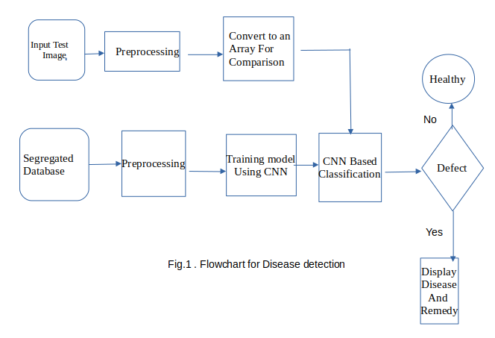
Approved by AICTE |Affiliated to VTU | Recognized by UGC with 2(f) & 12(B) status |Accredited by NBA and NAAC

Slide 7
Procedure
1.The input test image is acquired and preprocessed in the next stage and then it is converted into array form for comparison.
2.The selected database is properly segregated and preprocessed and then renamed into proper folders.
3.The model is properly trained using CNN and then classification takes place.
4.The comparison of the test image and the trained model take place followed by the display of the result.
5.If there is a defect or disease in the plant the software displays the disease along with the remedy .
Approved by AICTE |Affiliated to VTU | Recognized by UGC with 2(f) & 12(B) status |Accredited by NBA and NAAC

Slide 8
Image classification is the process of segmenting images into different categories based on their features.
An image consists of the smallest indivisible segments called pixels and every pixel has a strength often known as the pixel intensity.
Whenever we study a digital image, it usually comes with three color channels, i.e. the Red-Green-Blue channels, popularly known as the “RGB” values.
Now if we take multiple such images and try and label them as different individuals we can do it by analyzing the pixel values and looking for patterns in them.
However, the challenge here is that since the background, the color scale, the clothing, etc. vary from image to image, it is hard to find patterns by analyzing the pixel values alone. Hence we might require a more advanced technique that can detect these edges or find the underlying pattern of different features in the face using which these images can be labeled or classified. This where a more advanced technique like CNN comes into the picture.
Approved by AICTE |Affiliated to VTU | Recognized by UGC with 2(f) & 12(B) status |Accredited by NBA and NAAC

Slide 9
We discussed earlier that any color image has three channels, i.e. red, green, and blue.
The challenge with images having multiple color channels is that we have huge volumes of data to work with which makes the process computationally intensive.
The role of CNN is to reduce the images into a form that is easier to process, without losing features critical towards a good prediction.
CNN works by extracting features from the images.
The input layer which is a grayscale image
The Output layer which is a binary or multi-class labels
Hidden layers consisting of convolution layers, ReLU (rectified linear unit) layers, the pooling layers, and a fully connected Neural Network
Approved by AICTE |Affiliated to VTU | Recognized by UGC with 2(f) & 12(B) status |Accredited by NBA and NAAC

Slide 10
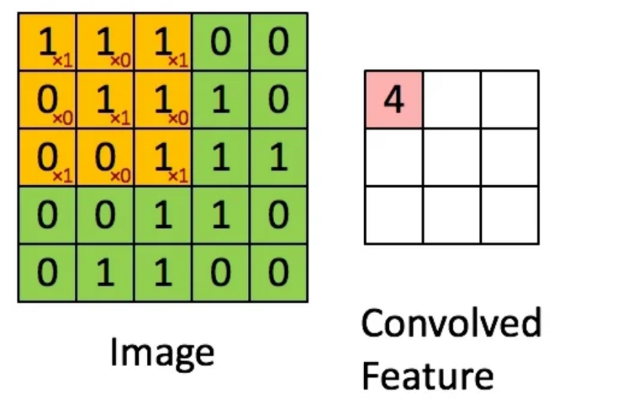
value equal to 4 in the convolved feature matrix as shown below.
Convolutional
Pooling is mainly to reduce the computational complexity required to process the huge volume of data linked to an image. Pooling is not compulsory and is often avoided.
Once the pooling is done the output needs to be converted to a tabular structure that can be used by an artificial neural network to perform the classification.
Approved by AICTE |Affiliated to VTU | Recognized by UGC with 2(f) & 12(B) status |Accredited by NBA and NAAC

Slide 11
Conclusion
The proposed system was developed taking in mind the benefits of the farmers and agricultural sector .
The developed system can detect disease in plant and also provide the remedy that can be taken against the disease.
By proper knowledge of the disease and the remedy can be taken for improving the health of the plant .The proposed system is based on python.
Approved by AICTE |Affiliated to VTU | Recognized by UGC with 2(f) & 12(B) status |Accredited by NBA and NAAC

